Slide 1
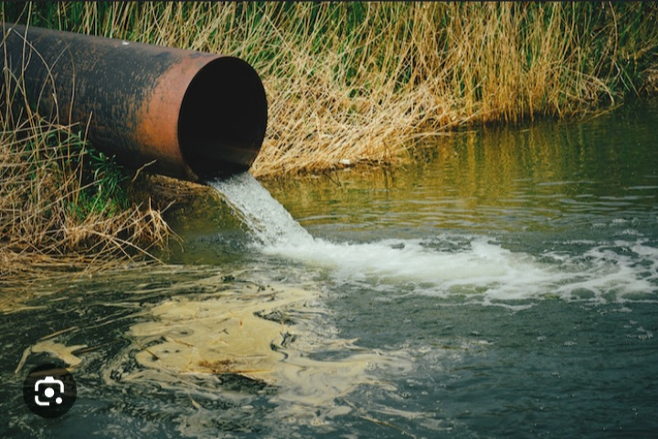
HOW AQUATIC ANIMALS SURVIVE IN HIGH AMMONIA ENVIRONMENT
GROUP 32

Slide 2
TABLE OF CONTENT
INTRODUCTION
SOURCES OF AMMONIA IN AQUATIC ENVIRONMENTS
EFFECTS OF HIGH AMMONIA CONCENTRATIONS ON AQUATIC ORGANISMS
ADAPTATIONS OF AQAUTIC ORGANISMS TO HIGH AMMONIA ENVIRONMENTS
CASE STUDIES OF AQUATIC ORGANISMS THAT SURVIVE IN HIGH AMMONIA ENVIRONMNETS
CONCLUSION

Slide 3
INTRODUCTION
Aquatic organisms live in environments with varying concentrations of ammonia.
High ammonia concentrations can be toxic to aquatic organisms, causing physiological stress and even death.

Slide 4
SOURCES OF AMMONIA IN AQUATIC ENVIRONMENTS
NATURAL SOURCES
ARTIFICIAL SOUCES
NB: The concentration of ammonia in the aquatic environment can vary depending on the sources and the time of day.

Slide 5
SOURCES OF AMMONIA IN AQUATIC ENVIRONMENTS
Reduced growth rates
Impaired immune function
Death
Fish are particularly sensitive to high ammonia concentrations and exposure can cause
Gill damage
Respiratory distress
Impaired osmoregulation

Slide 6
ADAPTATIONS OF AQUATIC ORGANISMS TO HIGH AMMONIA ENVIRONMENT
Excretion of excess ammonia through their gills
Conversion of ammonia into less toxic forms like urea or uric acid
Some organisms have also developed mechanisms to detoxify ammonia

Slide 7
CASE STUDIES OF AQAUTIC ORGANISMS THAT SURVIVE IN HIGH AMMONIA CONCENTRATION
Some examples of aquatic organisms that survive in high ammonia environments include certain species of fishes, crustaceans, and bacteria.
For instance the amazon catfish can tolerate ammonia concentration up to 20 times higher than what is lethal for other fish species
Another example is the brine shrimp, which can convert ammonia into urea and release it into the environment.
Bacteria like Nitrosomonas and Nitrobacter are also capable of oxidizing ammonia into nitrite and nitrate respectively.

Slide 8
CONCLUSION
The ability of aquatic organisms to survive in high ammonia environments is a testament to the diversity and resilience of life on earth.
By studying these organisms and their adaptaions, we can gain a better understanding of how life has evolved to cope with environmental stressors.

Slide 9
REFERENCES
1. Smith, C., & Wright, P. (Eds.). (2020). Ammonia: Its role in the environment and its impact on humans and other organisms. CRC Press.
2. Jobling, M. (2013). The adaptive significance of ammoniotelic excretion in fish. Comparative Biochemistry and Physiology Part A: Molecular & Integrative Physiology, 164(2), 295-303.
3. Wright, P. A. (2021). Nitrogen excretion: three end products, many physiological roles. The Journal of Experimental Biology, 224(14), jeb229179.

Slide 10
THANK YOU

